Slide 1

Bhavas Classification Using Deep Learning
Department of CSE
APRIL, 2021
Notes:
1
1
1
1
1

Slide 2
Group No: 24
Group Members :
Nova Dileep JEC17CS078
Shinoz Mohammed P P JEC17CS094
Sreelakshmi C (Team Leader) JEC17CS098
Github repo. : https://github.com/sreelakshmi182000/Group24
Name of mentor:
Ms. Reshma K V
Assistant Professor
CSE Department, JECC
Notes:
2

Slide 3
Vision of the Department
Creating eminent and ethical leaders in the domain of Computational Sciences through quality professional education with a focus on holistic learning and excellence.
Mission of the Department
To create technically competent and ethically conscious graduates in the field of Computer Science and Engineering by encouraging holistic learning and excellence.
To prepare students for careers in Industry, Academia and the Government.
To instill Entrepreneurial Orientation and research motivation among the students of the department.
To emerge as a leader in education in the region by encouraging teaching, learning, industry and societal connect.
CSE Department, JECC
Notes:
3

Slide 4
Contents
Introduction
Objective
Literature Survey
SRS
Architecture
Implementation in detail
Pending works
Conclusion
References
CSE Department, JECC
Notes:
4
4
4
4
4

Slide 5
Introduction
Bhavas classification using deep learning is used to classify the 9 bhavas of classical
dance such as ‘Sringara’(Love), ‘Hasya’(Comic), ‘Karuna’(Compassion),‘Raudra’
(Anger),‘Veera’ (Valor), ‘Bhayankara’(Fear), ‘BhiBhatsa’(Disgust), ‘Adbhuta’(Wonder),
‘Shantam’(Tranquility).
Steps involved in this system are
Identifying the dataset
Preprocessing of images
Extracting features from images
Identifying and classifying of bhavas
Training and testing
Finally accuracy is calculated.
CSE Department, JECC
Notes:
5
5
5
5
5

Slide 6
Objective
Dataset creation
Feature detection
Classification
Training and Testing
CSE Department, JECC
Notes:
6
6
6
6
6

Slide 7
Literature Survey
Human facial expression recognition using deep learning technique - S. Harshitha, N. Sangeetha, A. P. Shirly and C. D. Abraham
Facial Expression Recognition using Deep Learning - Vamshi. N R. and Raja S
Facial expression recognition via deep learning - Y. Lv, Z. Feng and C. Xu
Facial Expression Recognition with Faster R-CNN - Jiaxing Li, Dexiang Zhang, Jingjing Zhang, Jun Zhang, Teng Li, Yi Xia, Qing Yan, Lina Xun
Facial Expression Recognition with Convolutional Neural Networks - S. Singh and F. Nasoz
Face Expression Recognition Based on Convolutional Neural Network - L. Xu, M. Fei, W. Zhou and A. Yang
CSE Department, JECC
Notes:
7
7
7
7
7

Slide 8
SRS
Functional Requirement | Non Functional Requirement
The system should classify an image into one of 9 emotions | The system should be implemented in jupyter notebook
The system should include an automatic face detection algorithm
CSE Department, JECC
Notes:
8
8
8
8
8

Slide 9
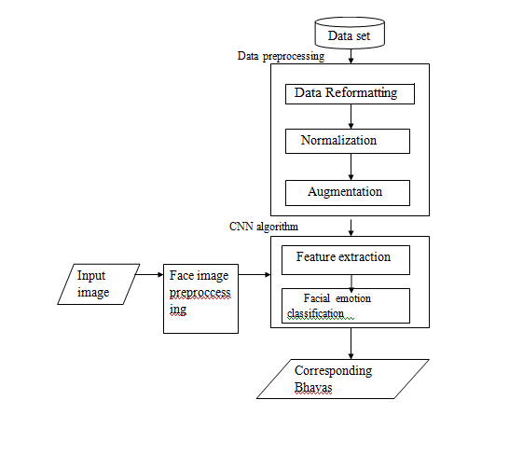
Architecture

Slide 10
DFD
Level -0
Facial expression classification
Input image
Bhavas

Slide 11
Level -1
Feature extraction(lip,eyes and eyebrows)
Input image
Data preprocessing
Facial expression clasification
Dataset
Bhavas

Slide 12
Implementation in Detail
The coding for the module - feature extraction
i.e, the extraction of facial features such as eyes, lips and eyebrows
Images are collected for the new dataset creation
CSE Department, JECC
Notes:
12
12
12
12
12

Slide 13
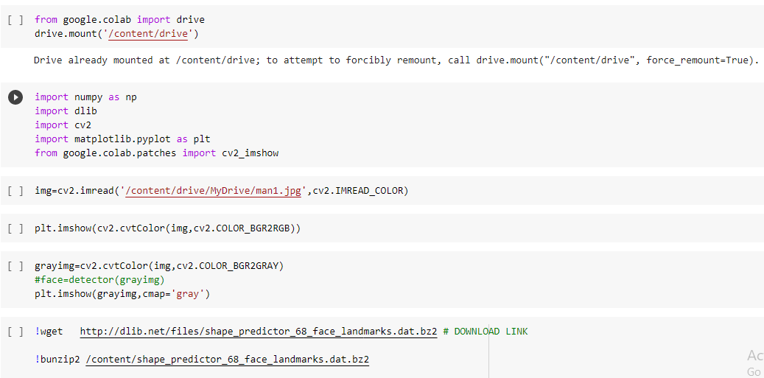
CSE Department, JECC
Notes:
13
13
13
13
13

Slide 14
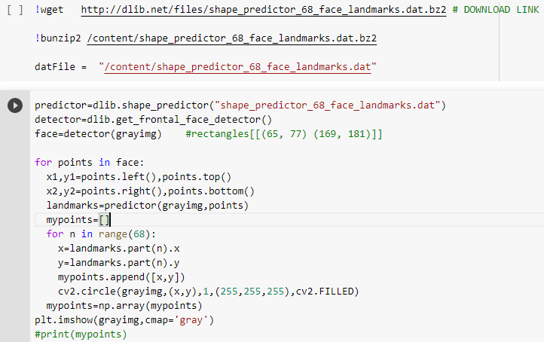
CSE Department, JECC
1/16/2021
14
Notes:
14
14
14
14
14

Slide 15
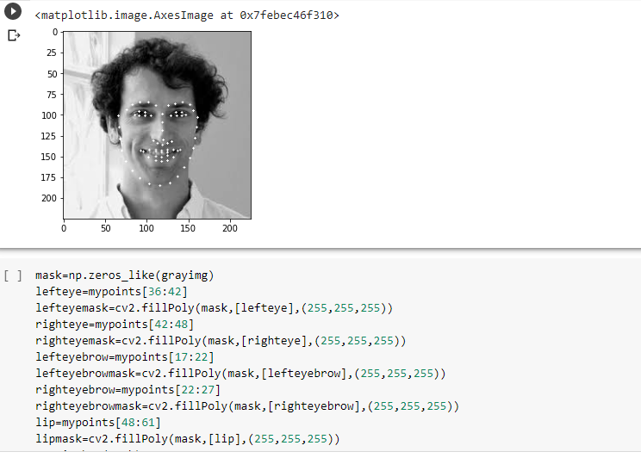

Slide 16
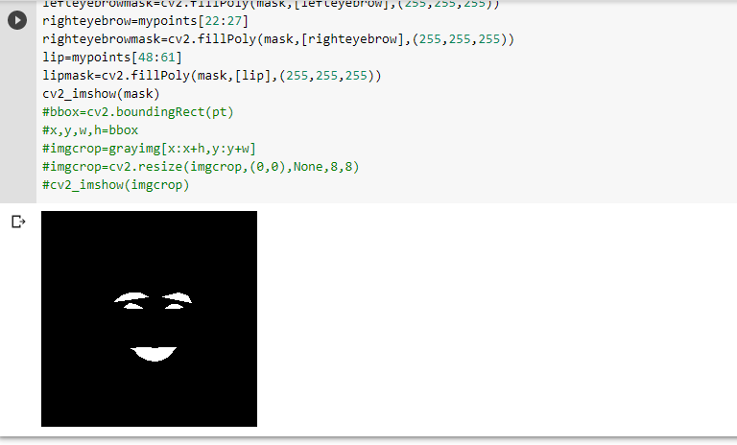

Slide 17

Image collection for the dataset
CSE Department, JECC
1/16/2021
17
Notes:
17
17
17
17
17

Slide 18
Contribution of each members
Nova - Coding (segmentation) , PPT creation
Shinoz - Image collection for the dataset, PPT creation
Sreelakshmi - Coding (landmark detection) , PPT creation
CSE Department, JECC
Notes:
18
18
18
18
18

Slide 19
Pending works
Expected Completion time - may 30th, 2021
Classification
Training and Testing
CSE Department, JECC
Notes:
19
19
19
19
19

Slide 20
Conclusion
Coding for the first and basic module of our project, feature extraction module has been completed which helps to automatically extract features rather than manual extraction
Images have been collected for the creation of dataset
Classification module is the pending work that has to be completed
CSE Department, JECC
Notes:
20
20
20
20
20

Slide 21
References
S. Harshitha, N. Sangeetha, A. P. Shirly and C. D. Abraham, "Human facial expression recognition using deep learning technique," 2019 2nd International Conference on Signal Processing and Communication (ICSPC), Coimbatore, India, 2019, pp. 339-342, doi: 10.1109/ICSPC46172.2019.8976876.
Vamshi. N, R. and Raja S, B., “Facial Expression Recognition using Deep Learning”, <i>arXiv e-prints</i>, 2020.
Y. Lv, Z. Feng and C. Xu, "Facial expression recognition via deep learning," 2014 International Conference on Smart Computing, Hong Kong, 2014, pp. 303-308, doi: 10.1109/SMARTCOMP.2014.7043872.
Jiaxing Li, Dexiang Zhang, Jingjing Zhang, Jun Zhang, Teng Li, Yi Xia, Qing Yan, Lina Xun,Facial Expression Recognition with Faster R-CNN,Procedia Computer Science,https://doi.org/10.1016/j.procs.2017.03.069.
CSE Department, JECC
Notes:
21
21
21
21
21

Slide 22
S. Singh and F. Nasoz, "Facial Expression Recognition with Convolutional Neural Networks," 2020 10th Annual Computing and Communication Workshop and Conference (CCWC), Las Vegas, NV, USA, 2020, pp. 0324-0328, doi: 10.1109/CCWC47524.2020.9031283.
L. Xu, M. Fei, W. Zhou and A. Yang, "Face Expression Recognition Based on Convolutional Neural Network*," 2018 Australian & New Zealand Control Conference (ANZCC), Melbourne, VIC, 2018, pp. 115-118, doi: 10.1109/ANZCC.2018.8606597.
CSE Department, JECC
Notes:
22
22
22
22
22

Slide 23
Thank You
CSE Department, JECC
Notes:
23

